Slide 1
Advanced Controls & Dialog Boxes

Slide 2
Objectives
In this module , you will learn about
ListView control
ProgressBar control
Timer component
DateTimePicker control
MonthCalendar control
Custom Controls
Dialog Boxes

Slide 3
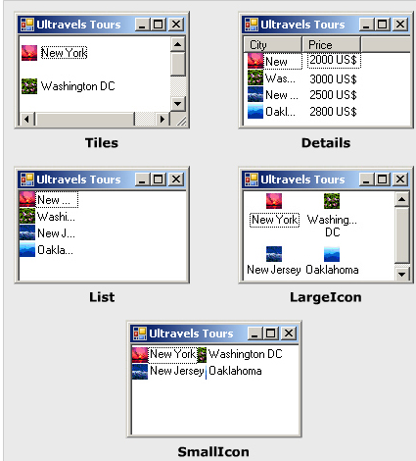
ListView control
Used to display a collection of items in a list
Can display items with theirs icons, which can be smal or large in size

Slide 4
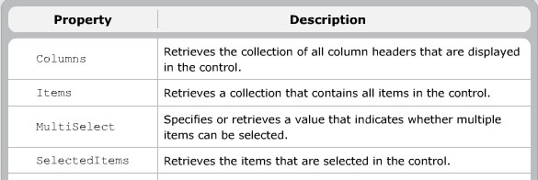
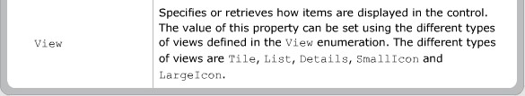
ListView Properties

Slide 5
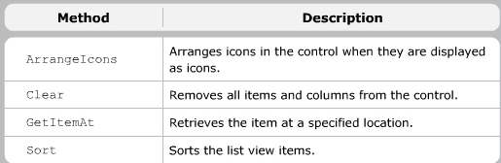
ListView Methods

Slide 6
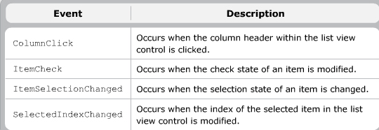
ListView Events

Slide 7
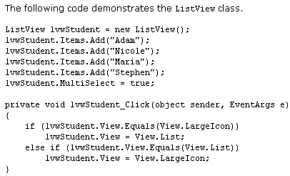
ListView ….

Slide 8
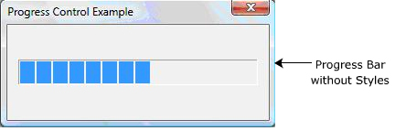

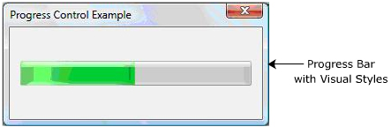
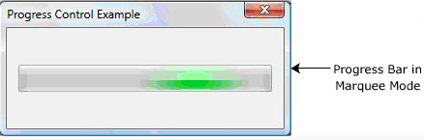
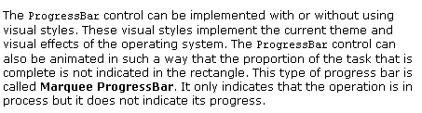
ProgressBar

Slide 9
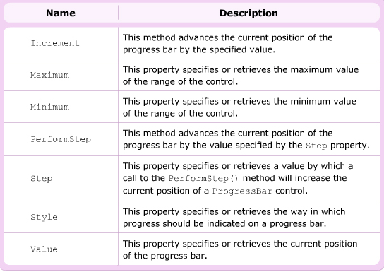
ProgressBar control

Slide 10

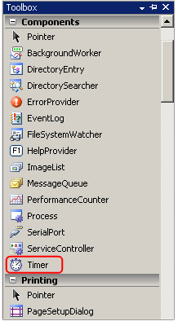
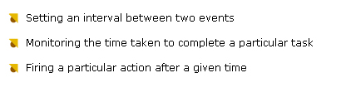
Timer Component

Slide 11
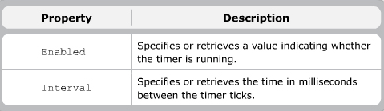
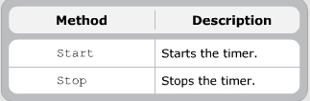

Timer Component

Slide 12
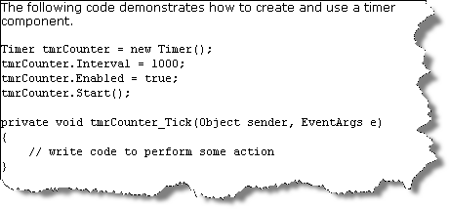

Timer Component

Slide 13

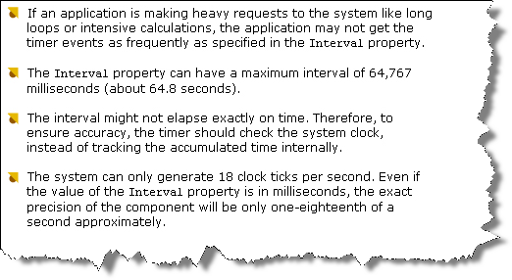
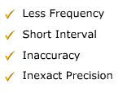
Timer Component

Slide 14
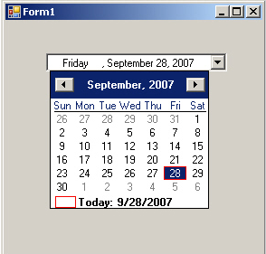
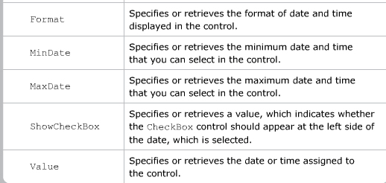
DateTimePicker control
Select an item from a list of dates or times
It appears as a textbox along with a drop-down calendar
Display the current date in a particular format
The calendar allows you to view the days of a week or browse through the months
Property
Description

Slide 15
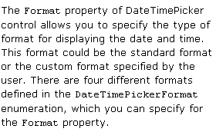
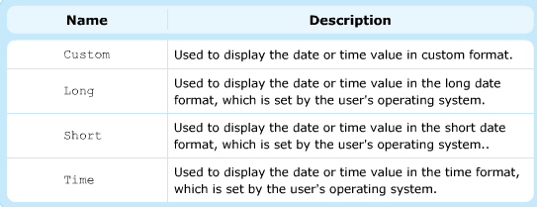
Format property
Custom
Long
Short
Time

Slide 16
CustomFormat property
Format String | Description
ddd | Display three character day of week abbreviation
dddd | Display full day-of week name
hh | Display two-digit hour in 12 hour format
HH | Display two-digit hour in 24 hour format.
mm | Display two-digit minute
MM | Display three-character month abbreviation
MMM | Display full month name
ss | Display two-digit seconds
t | Display the first letter of the AM/PM abbreviation
tt | Display two-letter AM/PM abbreviation
yy | Display last two-digit of the year
yyyy | Display full year name

Slide 17
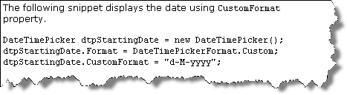
CustomFormat property

Slide 18
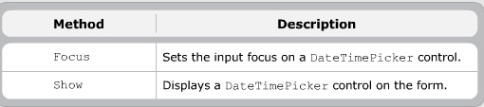
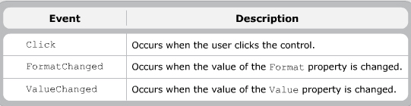
DateTimePicker Methods & Events

Slide 19
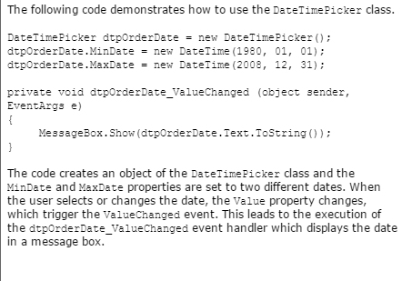
DateTimePicker Methods & Events

Slide 20
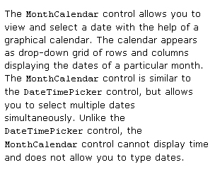
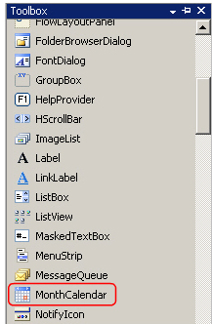
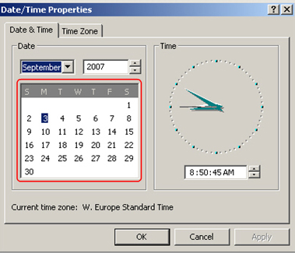
MonthCalendar control

Slide 21
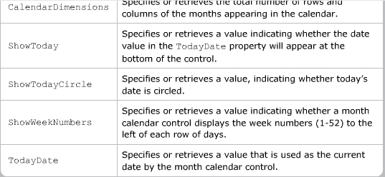
MonthCalendar control
Property
Description

Slide 22
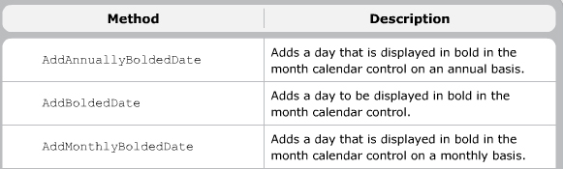
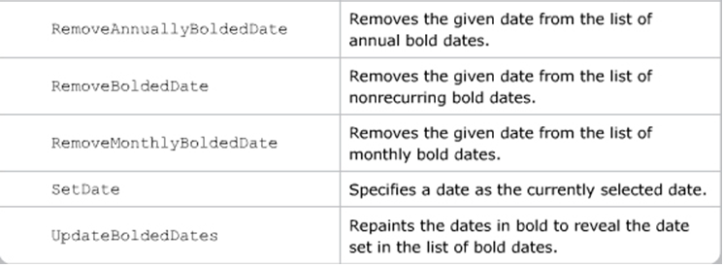
MonthCalendar control
AddAnnuallyBoldedDate
AddBoldedDate
AddMonthlyBoldedDate
RemoveAnnuallyBoldedDate
RemoveBoldedDate
RemoveMonthlyBoldedDate
SetDate
UpdateBoldedDate

Slide 23
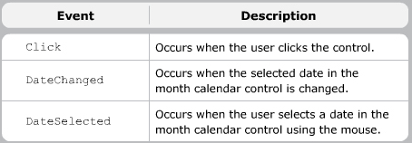
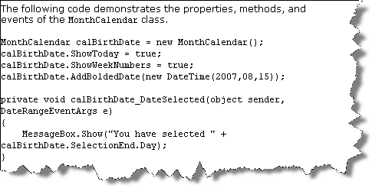
MonthCalendar control

Slide 24
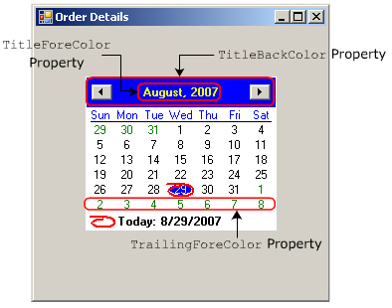
MonthCalendar control
Property
TitleBackColor
TitleForeColor
TrailingForeColor
ShowTodayCircle

Slide 25

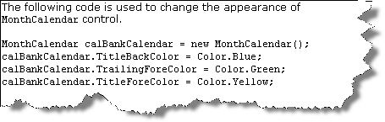
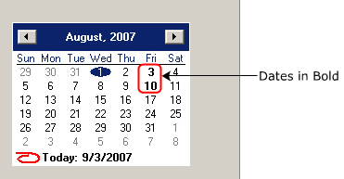
MonthCalendar control

Slide 26
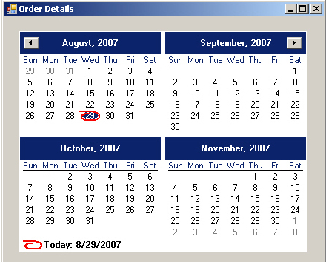
Display multiple months
The CalendarDimensions property to set the number of months to be displayed horizontally and vertically

Slide 27
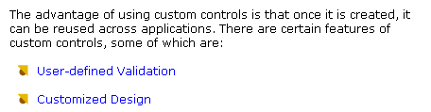


Custom Controls

Slide 28
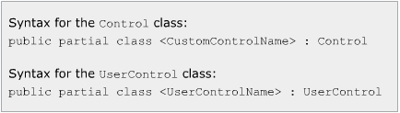
Types of custom controls
Composite
Inherit the UserControl class
Combine som controls
Extended
Inherit any Windows Form control
Custom
Inherit Control class

Slide 29
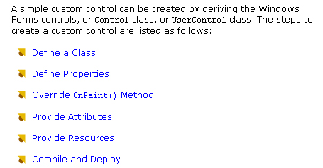
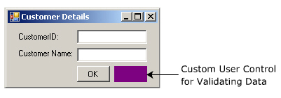
Steps to create Simple Custom controls

Slide 30
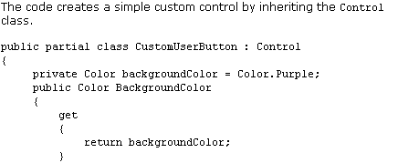
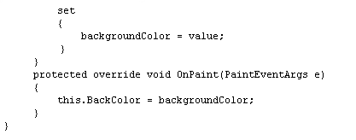

Slide 31
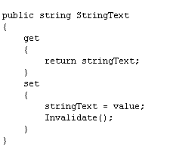
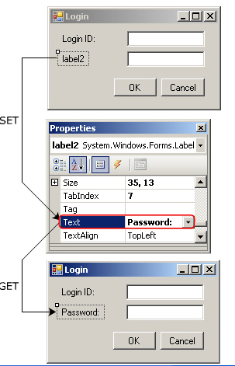
Adding properties using Accessors

Slide 32
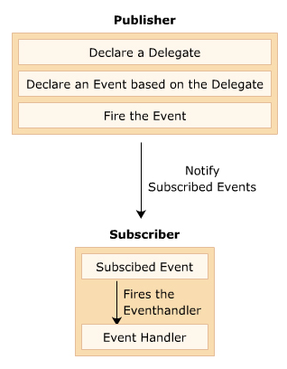
Associating events with custom controls
public event EventHandler Leave
this.btnCustom += new System.EventHandler(the_fun)
public void the_fun(object sender , EventArgs e)
{
………….
}

Slide 33
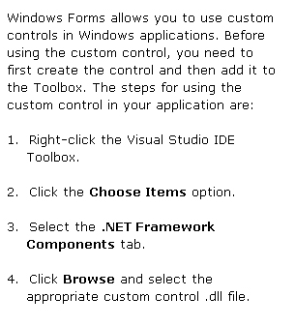
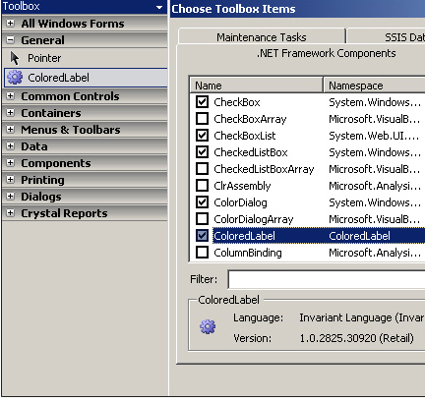
Steps for using custom controls

Slide 34
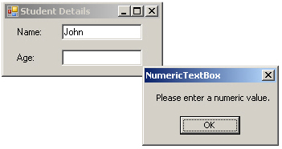

Using custom controls programmaticaly
Namespace of CustomControl

Slide 35


Custom controls (cont ..)
[@ToolboxBitmap(“C:\\demo.bmp”)
public partial class CustomControl : UserControl
{
-----------------------------------
}

Slide 36

Inherit existing controls

Slide 37


Inherit existing controls (ctn)

Slide 38



Composite Control

Slide 39


Step by Step
You can create Window Control Library project

Slide 40



Dialog Boxes

Slide 41


Classification of Dialog Boxes
A Dialog box is a window that allows you to collect and display related information using various controls

Slide 42


INTRODUCTION TO DIALOGBOX

Slide 43


FEATURES

Slide 44


MODAL DIALOG BOX

Slide 45


MODELESS DIALOG BOX
- A modeless dialog box allows user to focus and work with the same application without closing the dialog box.
- A modeless dialog box allows you switch between the application window and the dialog box.

Slide 46



COMMON DIALOG BOXES

Slide 47

CommonDialog Class
The CommonDialog class is the base class for all common dialog boxes
The class exists in the System.Windows.Forms namespace

Slide 48


COMMON DIALOG CLASS

Slide 49


ColorDialog Box

Slide 50

ColorDialog Box

Slide 51


FontDialog Box

Slide 52

FontDialog

Slide 53



OpenFileDialog & SaveFileDialog
Allows you open a file

Slide 54

PageSetupDialog Box
System defined Dialog Box
Set PageLayout of printing (border , margin, header and footer – portrait and lanscape orientation)

Slide 55

PrintDialog Box
System defined Dialog Box
Select a printer
Choose the pages to print
Number of copies
Some print-related settings

Slide 56

PrintPreviewDialog
Used to display the way a document will appear when printed ( before)
This control contains Icon for printing, zooming in , displaying one or multiple pages

Slide 57


PrintPreviewDialog

Slide 58

User-Defined Dialog Box

Slide 59

CustomDialog

Slide 60


Retrieving Info from a Dialog Box

Slide 61

DialogResult Enumeration

